Slide 1


Chapter 16
Evaluation: Inspections, Analytics, and Models

Slide 2
Goals
Describe the key concepts associated with inspection methods
Explain how to do heuristic evaluation and walkthroughs
Explain the role of analytics in evaluation
Describe how A/B testing is used in evaluation
Describe how to use Fitts’ Law – a predictive model
Notes:
2

Slide 3
Inspections
Several kinds
Experts use their knowledge of users and technology to review software usability
Expert critiques can be formal or informal
Heuristic evaluation is a review guided by a set of heuristics
Walkthroughs involve stepping through a pre-planned scenario noting potential problems
Notes:
3

Slide 4
Heuristic evaluation
Developed by Jacob Nielsen in the early 1990s
Based on heuristics distilled from an empirical analysis of 249 usability problems
These heuristics have been revised for current technology by Nielsen and others for:
Mobile devices
Wearables
Virtual worlds
Social media
…
Design guidelines form a basis for developing heuristics
Notes:
4

Slide 5
Revised version (2014) of Nielsen’s original heuristics (continued)
Recognition rather than recall
Flexibility and efficiency of use
Aesthetic and minimalist design
Help users recognize, diagnose, recover from errors
Help and documentation
Notes:
5

Slide 6
Revised version (2014) of Nielsen’s original heuristics
Visibility of system status
Match between system and real world
User control and freedom
Consistency and standards
Error prevention
Notes:
6

Slide 7
Number of evaluators and problems
Curve showing the proportion of usability problems in an interface found by heuristic evaluation using different numbers of evaluators
Source: Nielsen and Mack, 1994. Courtesy of Wiley.
Notes:
7

Slide 8
Number of evaluators
Nielsen suggests that on average five evaluators identify 75-80 percent of usability problems
Cockton and Woolrych (2001) point out that the number of users needed to find 75-80 percent of usability problems depends on the context and nature of the task problems
Notes:
8

Slide 9
Heuristics for websites focus on key criteria
Clarity
Minimize unnecessary complexity and cognitive load
Provide users with context
Promote positive and pleasurable user experience
Source: Budd, 2007

Slide 10
Doing heuristic evaluation
Briefing session to tell experts what to do
Evaluation period of 1-2 hours in which:
Each expert works separately
Take one pass to get a feel for the product
Take a second pass to focus on specific features
Debriefing session in which experts work together to prioritize problems
Notes:
10

Slide 11
Advantages and problems
Few ethical and practical issues to consider because users not involved
Can be difficult and expensive to find experts
Best experts have knowledge of application domain and users
Biggest problems:
Important problems may get missed
Many trivial problems are often identified, such as false alarms
Experts have biases
Notes:
11

Slide 12
Turning design guidelines and golden rules into heuristics
Ask questions like the following:
“Does the application include a visible title page, section or site? Does the user always know where they are located? Does the user always know what the system or application is doing? Are the links clearly defined? Can all actions be visualized directly (i.e., no other actions are required)?”
Granollers, 2018, p. 62
Notes:
12

Slide 13
Evaluating for accessibility using Guidelines
Web Content Accessibility Guidelines (WCAG) (see Lazar et al., 2015)
Guidelines can be used as heuristics for evaluating websites
Governments and large corporations have to make their websites accessible by law
Four key concepts:
Perceivable
Operable
Understandable
Robust
Source: WCAG 2.1 at a Glance.
Notes:
13

Slide 14
Cognitive walkthroughs
Focus on ease of learning
Designer presents an aspect of the design and usage scenarios
Expert is told the assumptions about user population, context of use, task details
One or more experts walk through the design prototype with the scenario
Experts are guided by three questions
Notes:
14

Slide 15
The three questions
Will the correct action be sufficiently evident to the user?
Will the user notice that the correct action is available?
Will the user associate and interpret the response from the action correctly?
As the experts work through the scenario, they note problems
Notes:
15

Slide 16
Pluralistic walkthrough
Variation on the cognitive walkthrough theme
Performed by a carefully managed team
The panel of experts begins by working separately
This is followed by a managed discussion that leads to agreed decisions
The approach lends itself well to participatory design
Also other adaptations of basic cognitive walkthroughs
Notes:
16

Slide 17
Web Analytics
A form of interaction logging that analyzes users’ activities on website
Designers use the analysis to improve their designs
When designs don’t meet users’ needs, they will not return to the site
They become one-time users
Notes:
17

Slide 18
Web Analytics (continued)
Web analytics enable designers to track the activities of users on their site
They can see how many people come to the site, how long they stay, and where they go
Web analytics offer designers the “big picture” about how their site performs based on user activity
One of the most well-known analytics
Notes:
18

Slide 19
Segment of Google Analytics for Interaction Design 5e website, December 2018

Slide 20
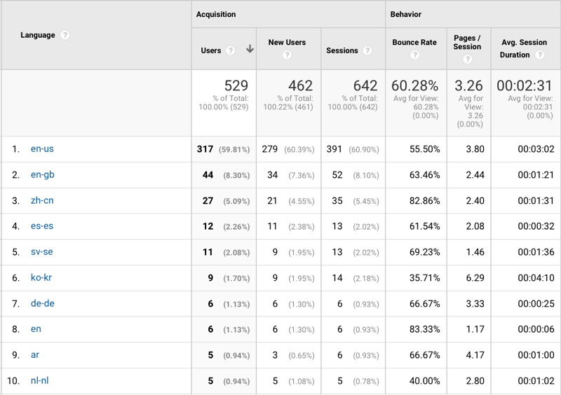
Segment of Google Analytics for Interaction Design 5e website, December 2018 (continued)

Slide 21
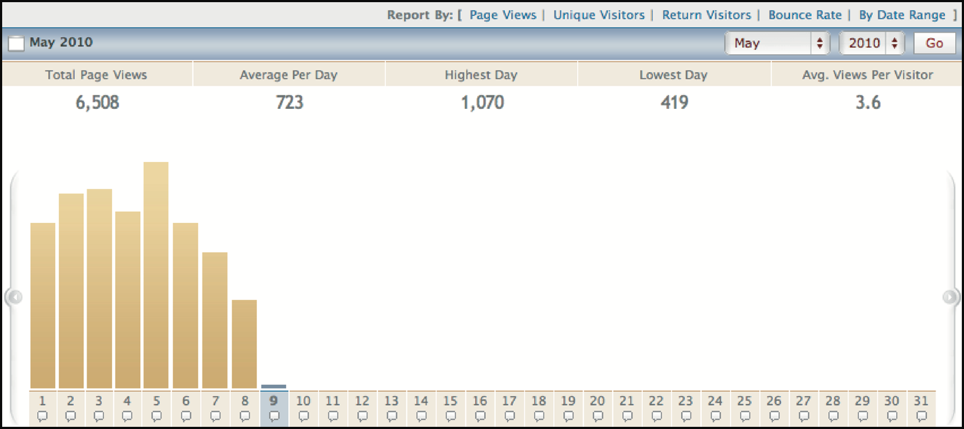
Segment of early VisiStat Analytics from 2010
Source: VisiStat Analytics, 2010

Slide 22
Segment of early VisiStat Analytics from 2010 (continued)
Where visitors to Mountain Wineries in California come from
Source: VisiStat Analytics, 2010

Slide 23
A/B Testing
A large-scale experiment
Offers another way to evaluate a website, application of app running on a mobile device
Often used for evaluating changes in design on social media applications
Compares how two groups of users perform on two versions of a design
Notes:
23

Slide 24
A/B Testing (continued)
Can involve thousands of users
May create ethical dilemmas if users don’t know they are part of the test
Care is needed to ensure that other issues are not affecting users’ behavior
Notes:
24

Slide 25
Predictive models
Provide a way of evaluating products or designs without directly involving users
Less expensive than user testing
Usefulness limited to systems with predictable tasks, for example, voicemail systems, smartphones, and dedicated mobile devices
Based on expert error-free behavior
Notes:
25

Slide 26
Fitts’ Law (1954)
Fitts’ Law predicts that the time to point at an object using a device is a function of the distance from the target object and the object’s size
The further away and the smaller the object, the longer the time to locate it and point to it
It is particularly useful for determining where on a screen to position an object
Fitts’ Law is useful for evaluating systems for which the time to locate an object is important, for example, smartphones, handhelds, and mobile devices
Notes:
26

Slide 27
Summary
Inspections can be used to evaluate requirements, mockups, functional prototypes, or systems
User testing and heuristic evaluation may reveal different usability problems
Design guidelines can be used to develop heuristics
Walkthroughs are a fine-grained focused method for evaluating small parts of a product
Notes:
27

Slide 28
Summary (continued)
Analytics involves collecting data about users activity on a website or product to see which parts are used
A/B testing is a form of large-scale experiment
Fitts’ Law can be used to predict expert, error-free performance for clearly defined tasks with limited key presses, for example, to evaluate keypress sequences for handheld devices and the position of objects on a screen
Notes:
28

